Slide 1

FLEXIBILITY – DEMAND SIDE MANAGEMENT
FORUM-REFLEX
23.04.2014
FEBEG position

Slide 2
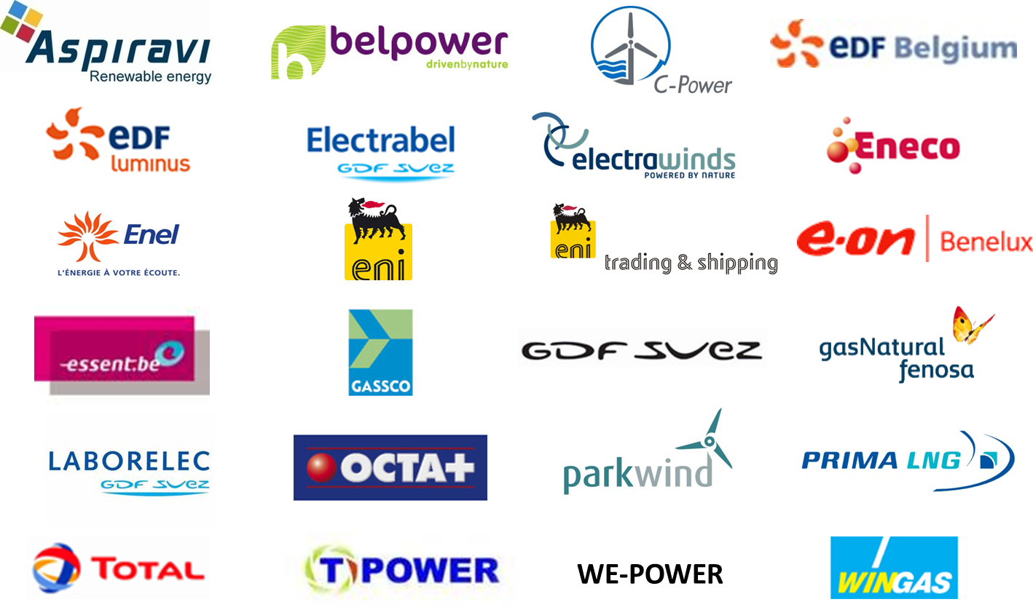
MEMBERS

Slide 3
Gestion Active de la Demande (GAD)
Real impact analysis still needs to be exectuded;
GAD has impact on commodity and could not be accepted by suppliers:
  Does not respect the roles in the market (undbundling): commodity = commercial activity;
  Price signal can not be influenced by DSO: not in line with sourcing on wholesale markets: energy is sourced at high prices, while supplier is obliged to sell at low prices
    Change in day and night hours ratio: less revenues for suppliers;
    Manipulation of demand by DSO influencing the consumption profile undermines the BRP balancing responsibility: BRP should be able to anticipate structural shifting of consumption profiles
    Variable grid tariffs complexifies the central SPOC role of supplier
  Impact on the revenues PV (delta price versus day tariff)
  General rule for all periods of time; useless for periods without sun;

Slide 4
QUESTIONS

Slide 5
CONTACT
Steven Harlem
steven.harlem@febeg.be
0032-2 500 85 89
www.febeg.be

